Slide 1
МІНІСТЕРСТВО ОСВІТИ І НАУКИ, МОЛОДІ ТА СПОРТУ УКРАЇНИ
НАЦІОНАЛЬНИЙ АВІАЦІЙНИЙ УНІВЕРСИТЕТ
Факультет аеронавігації, електроніки та телекомунікації
Кафедра аеронавігаційних систем
Назва конкурсу:
«Авіаційна та ракетно-космічна техніка. Аеронавігація»
Назва роботи:
«Оптимізація потоків автономних маршрутів БПЛА в багаторівневому повітряному просторі»
2020
Виконав: Бурлака Олександр Миколайович, група 119М, магістр
спеціальність 272 «Авіаційний транспорт»
освітньо-професійна програма «Безпілотні авіаційні комплекси»
Науковий керівник: професор кафедри АНС, д.т.н. Шмельова Т.Ф.

Slide 2
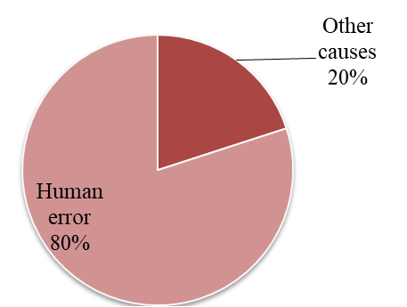
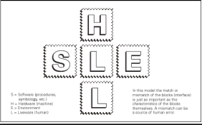
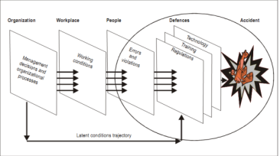
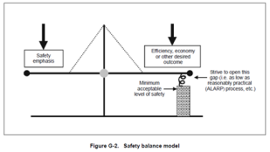
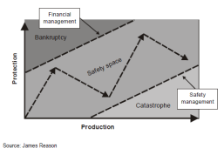
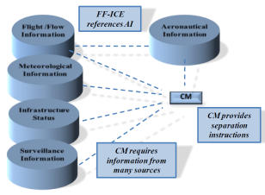
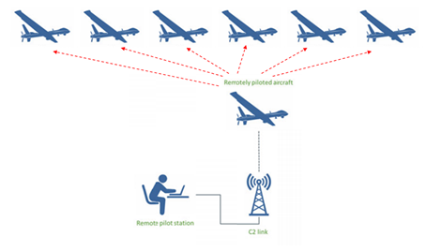
Human Factors (HF) problem. Evolution of HFs Models. Artificial Intelligence (AI) for aviation.
Unmanned Aerial Vehicles
<SHEL→SHELL→SHELL-T→SCHELL → balance models → Collaborative Decision Making (CDM) → AI / UAV → >
SCHELL model and CRM
C - culture
SCHELL-T model M
T – TEAM
Balance models →Collaborative Decision Making (CDM) / AI
Artificial Intelligence (AI )
Socio-technical systems
Culture is a “collective programming of the mind” (Hofstede)
ICAO: Human Factors Guidelines for Safety Audits Manual, Doc. 9806
Statistical data shows that human errors account for up to 80 % of all causes of aviation accidents
Artificial Intelligence (AI ):
SWIM -System-Wide Information Management
PBA - Performance-based approach
CDM - Collaborative decision making
DM - Decision Making
ES – expert systems
DSS – decision support system,
UAV in aviation
FF-ICE - Flight and Flow Information for a Collaborative Environment etc.
SHELL model
James Reason model - mistakes
Safety - effectivity /balance model
AI / CDM - Collaborative DM / UAVs flights
2

Slide 3
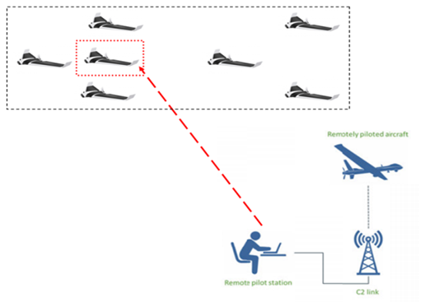
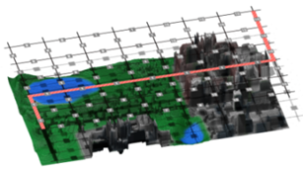
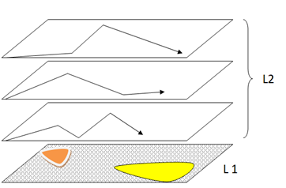
The purposes of the work
building an Expert system (ES) as Artificial Intelligence (AI) for estimation of the performance of UAVs flights (group and single) for the decision of different target tasks in an urban locality;
definition safe and minimal cost ways UAVs movement in town using GRID analysis, dynamic programming methods, methods of decision making under the risk and fuzzy-logic.

Slide 4
Evolution Human factor's models
Years | Models | Content of models | Content
1972 | SHEL | Software (procedures) - Hardware (machines) - Environment - Liveware | I stage Professional skills Interaction Errors
1990 | Reason's “Swiss Cheese Model” | Active errors - Latent errors - Windows of opportunity - Causation chain
1993 | SHELL | Software (procedures) - Hardware (machines) - Environment - Liveware - Liveware (humans)
1999 | CRM | Crew - Resource - Management | II stage Cooperation in team Error detection
2000 | TEM | Threat and Error - Management
2000 | MRM | Maintenance - Resource - Management
2004 | SHELL-T (SHELL-Team) | Software (procedures) - Hardware (machines) - Environment – Liveware - Liveware (humans) - Team
2004 | SCHELL model and CRM | Software (procedures) – Culture - Hardware (machines) - Environment - Liveware - Liveware (humans) | III stage Culture Safety Error prevention
2004 | LOSA | Line - Operation - Safety - Audit
2009 | HEAD | Human - Environment - Analysis - Design
 | PBA | Performance-Based Approach
2010 | HFACS | Human Factors - Accident - Classification - System
2013 | SMS Safety Balance Model | Safety Management System | IV stage Safety / Efficiency / Minimization of errors
2016-now | AI CDM | Collaborative Decision Making (CDM) System-Wide Information Sharing and Management (SWIM) Flight & Flow Information for a Collaborative Environment (FF-ICE), UAVs | V stage Collaborative DM Artificial Intelligence
4

Slide 5
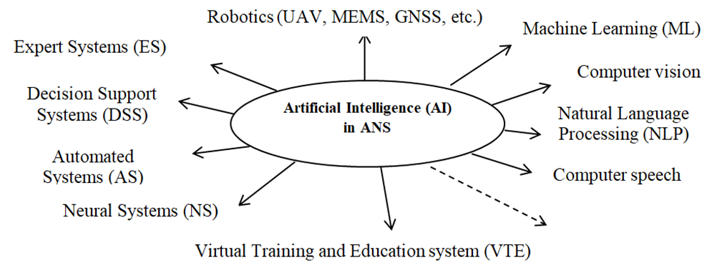
Artificial Intelligence for Air Navigation Systems development
ICAO defined new added approaches for achieving the main goal of ICAO enhancing the effectiveness of global aviation security, and improving the practical and sustainable implementation of preventive aviation security measure. The Global Aviation Security Plan (GASP) identifies five key outcomes for improving effectiveness, such as:
enhancing awareness and response of risk;
development of security culture and human capability;
improving technological resources and foster innovation;
improving oversight and quality assurance;
increasing cooperation and support between states.

Slide 6
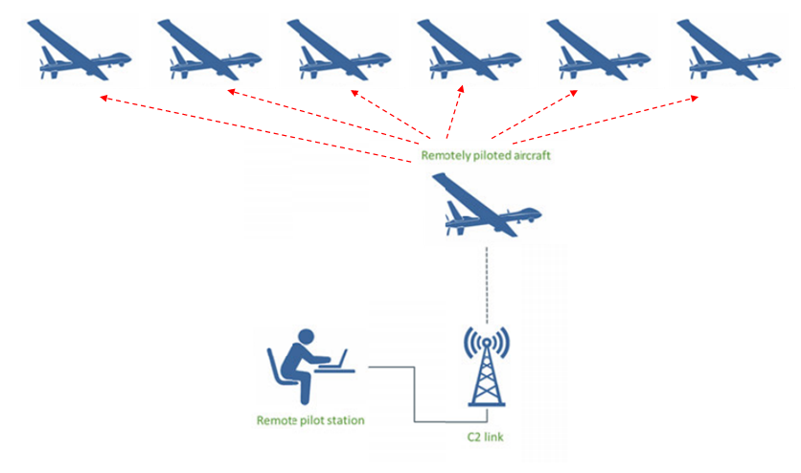
Control system of UAV’s group
To control a group of drones, the authors suggest choosing and using a Drone - Repeater to be connected to the operator on the ground and control other drones (Fig.1). To select the effective Drone – Repeater and optimal configuration network of UAV group, we use the same method of server selection in computer networks.
Fig. 1 Control system of UAV’s group from RPAS using Drone - repeater

Slide 7
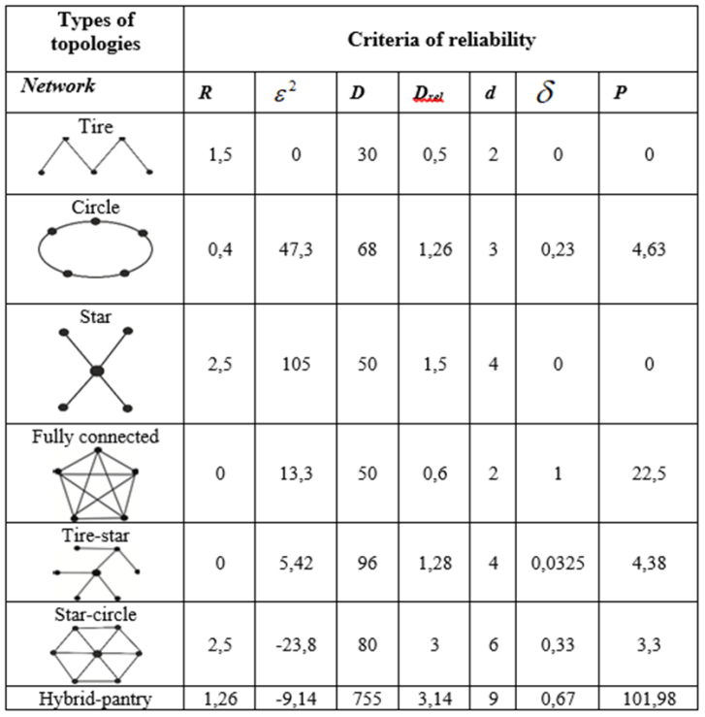
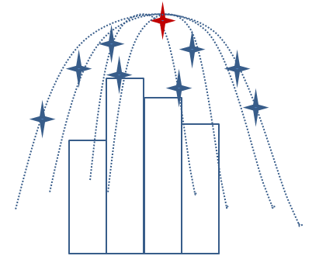
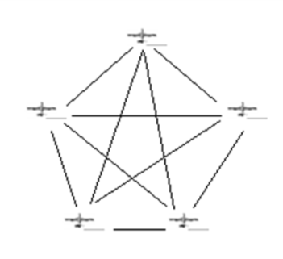
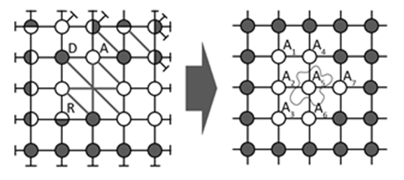
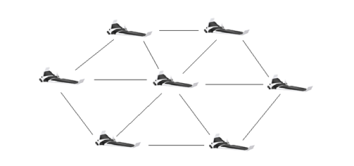
Control system of UAV’s group
To control a group of drones, the authors suggest choosing and using a Drone - Repeater to be connected to the operator on the ground and control other drones.
To select the effective Drone – Repeater and optimal configuration network of UAV group, were used the methods of:
choosing effective central Drone in the group analogically a selection server in computer networks
geometric modeling analogically in a building production was used the same method of server selection in computer networks.
optimal classic configuration (tire, star, circle, etc )
optimal complex configuration
7

Slide 8
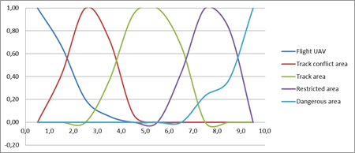
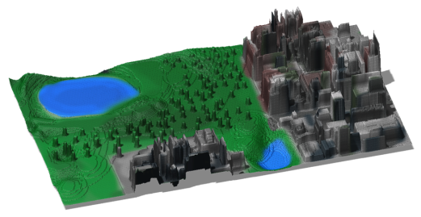
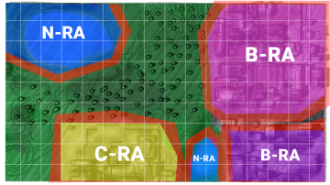
Estimation of areas in fragment of the territory (EJM & Fuzzy-logic)
The use of UAVs is more applicable in retranslation of communication in places - where some antennas cannot be set because of complacency of terrain, agriculture (group of spraying fields), with aerial photography (group survey of large areas, monitoring for appearance of forest fires, patrolling issues etc.), transportation of cargo.
The evaluation of areas attributed by obstructions:
Fuzzy-logic function of estimation risk
“Very low risk” corresponds to the quantitative significance of the level of risk in 10.
“Low risk” corresponds to the quantitative significance of the level of risk in 35;
“Average risk” corresponds to the quantitative significance of the level of risk in 60;
“High risk” corresponds to the quantitative significance of the level of risk in 80;
“Very high risk” corresponds to the quantitative significance of the level of risk in 100.
8

Slide 9
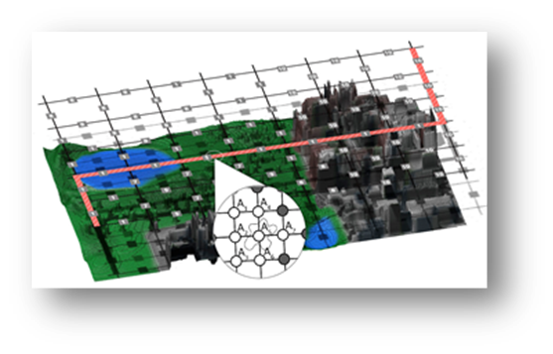
Algorithm of determining the optimal configuration of the group
Grid-analysis: a grid is superimposed on a fragment of terrain;
Risk assessment of Grid cells depending on the type of area (“Restricted” ; “Dangerous” or “Tracks”;
Finding the minimum cost path W1 for a UAV1 (UAVs group) using the DP method for planning a flight in a level L1:
Assessing the path W1 (UAVs group) of the UAV1 as “Dangerous”;
Finding the minimum cost path W2 for a UAV2 (UAVs group) using the DP method for planning a flight in a level L1, if necessary, the transition to the level L2, etc.
Building Discrete Network Model for “cover” (optimal configuration of UAVs group) and finding corridor for of UAVs group flight.
The optimal network configuration of UAV’s group obtained using Discrete Network Mode (DNM) by geometric modeling method. For example, estimation and finding the minimum cost path W1 for a UAV1 or UAVs group, W1=39 for fragment of the territory.

Slide 10
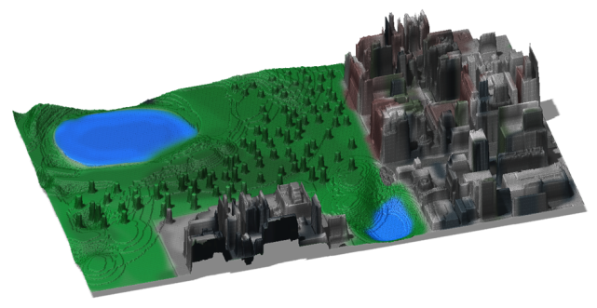
Using UAVs for flights in “smart city”
The concept of “smart city” is characterized by using the new achievements for the effective organization of life in a town. This is using artificial intelligence (AI), UAVs; Internet technologies, robotics,, the internet of things, etc.
Such objects in a town include:
bridges and tunnels,
roads and railways,
communication systems,
water supply and drainage systems,
power supply systems, and various large industrial facilities,
airports, rail railway stations, seaports, etc.
The authors present a problem of the performance of UAV’s flights (group or single flight) for the decision of different target tasks in the city using information Air Navigation Technology and Methods of Mathematical modeling (graph theory, Expert Judgment Method, methods of decision making in risk and fuzzy-logic, dynamic programming, geometrical modeling, etc.).
10

Slide 11
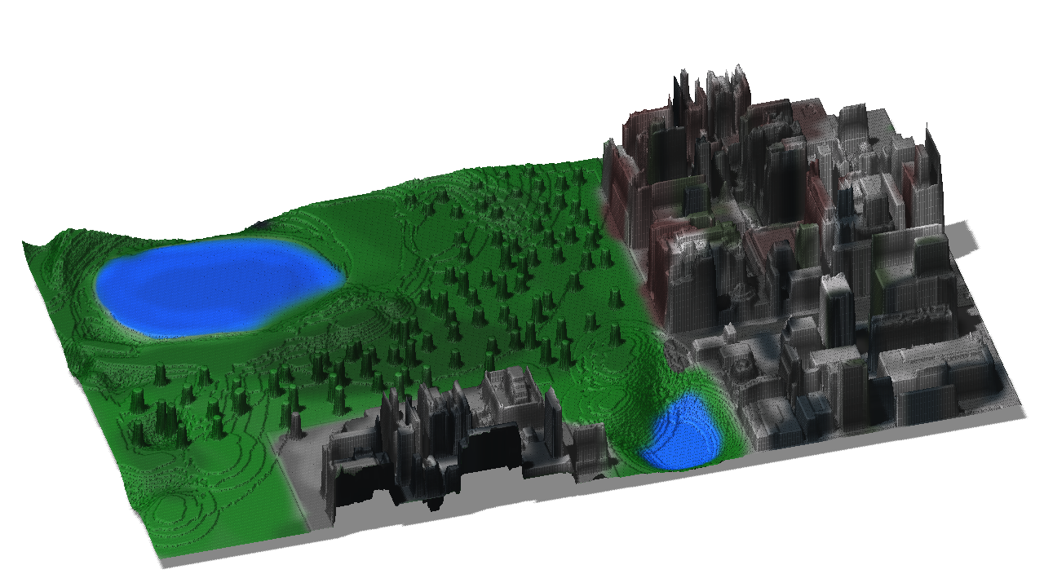
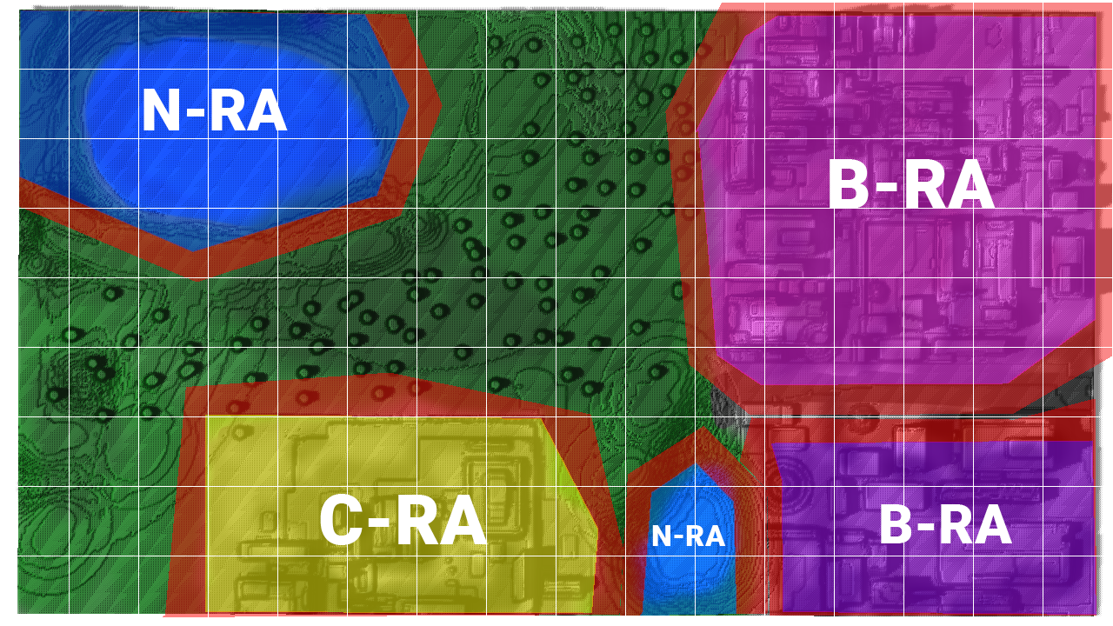
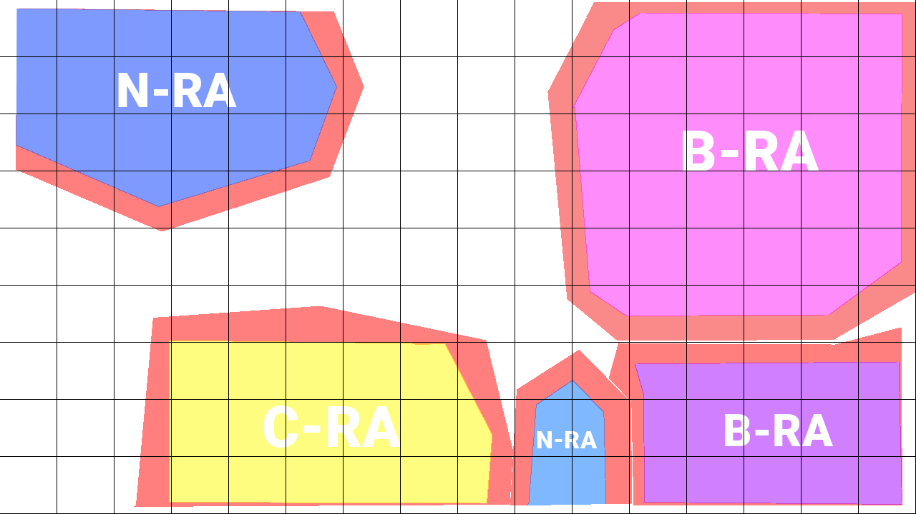
Example of estimation minimal cost and safety of UAVs movement
Dynamic Programming (DP), EJM, and fuzzy logic were used for estimation of risks and minimal cost of movement. To define minimal cost and safety of UAV movements in town we may apply mathematical methods (dynamic programming, geometrical modeling) and air navigation rules. Estimation of areas in fragment of the territory is depicted below.

Slide 12
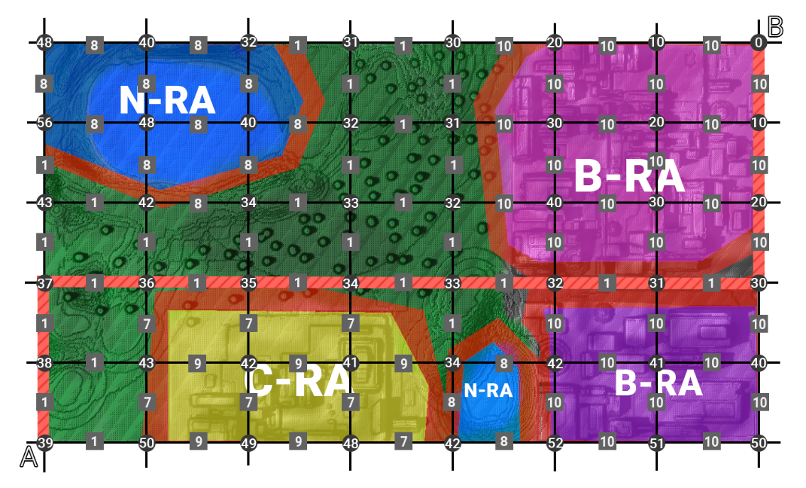
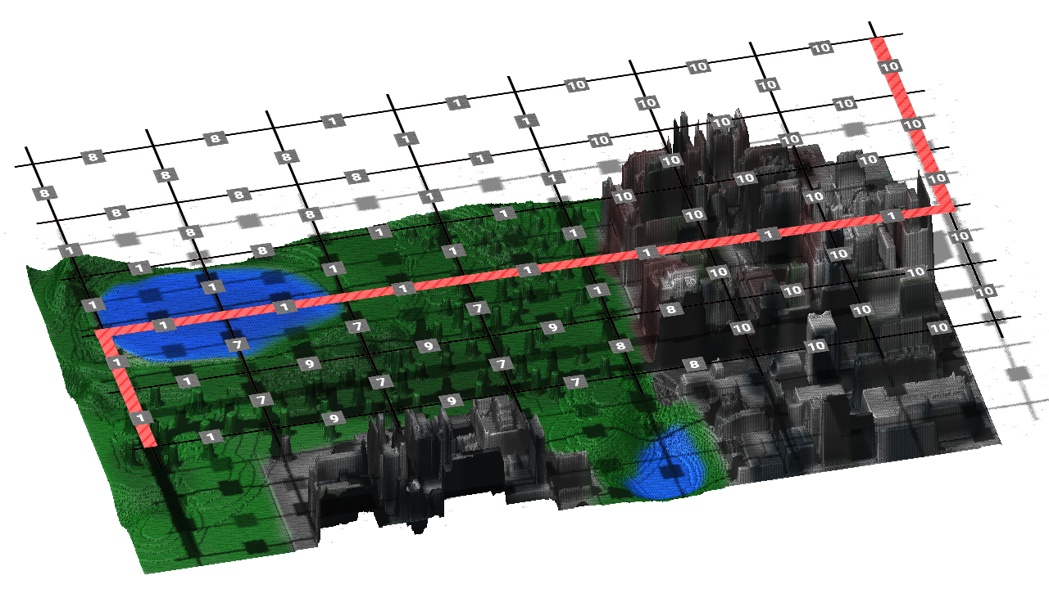
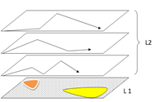
Minimal cost of UAV movement in town using dynamic programming methods
On next steps, we are planning to consider Multi-criteria decision analysis (MCDA) multi-criteria assessment of the performance of aviation chemical works by a group of manned and unmanned aircraft, such as airplanes, helicopters, UAV too.

Slide 13
Conclusion
To control a group of drones, the authors suggest choosing and using a Drone - Repeater to connection to the operator on the ground and to control of the drones in group flight.
To select the effective Drone – Repeater and optimal configuration network of UAV’s group, the authors used the method of server selection in computer networks.
The performance of group flight was analyzed, it was used graph theory for quantitative estimation of effectiveness of UAVs group flight.
Enhanced versatility in execution of complex tasks and missions is possible to achieve by separating management and control functions into a protocol stack model with conceptual levels encapsulating services and offering them to the higher levels of management.

Slide 14
References
Austin, R. (2010). Unmanned Aircraft Systems: UAVs Design, Development and Deployment. UK: John Wiley & Sons Ltd.
Gulevich S.. Analisis of factors affecting the safety of the flight of unmanned aerial vehicles / S. Gulevich, Y.Veselov, S.Pryadkin, and S.Tirnov // “Science and education,” №12, December 2012.
Ганин С.М. Беспилотные летательные аппараты / С.М.Ганин, А.В.Карпенко Санкт-Петербург 1999 - 160с.
Иноземцев Д.П. Беспилотные летательные аппараты: теория и практика / Д.П. Иноземцев // . Санкт-Петербург 2014 – 50 с.
Бурлака О.М. Перспективи розвитку нейронних мереж в САК БПЛА / О.М. Бурлака, О.В. Михайловський, Л.В. Благая // Проблеми розвитку глобальної системи зв’язку, навігації, спостереження та організації повітряного руху CNS/ATM наук.-техн. конф., Київ, 21-23 листопада 2018 р. : тези доповідей. – К. : Національний авіаційний університет, 2018. – С. 11.53-11.59
Unmanned Aerial Vehicles in Civilian Logistics and Supply Chain Management. Chapter 5 Automated System of Controlling Unmanned Aerial Vehicles Group Flight /Tetiana Shmelova, Dmitriy Bondarev - International Publisher of Progressive Information Science and Technology Research, USA, Pennsylvania. – November, 2019. – P. 167-204
Unmanned Aerial Vehicles: Breakthroughs in Research and Practice. Information Resources Management Association (USA)/ Chapter 8 Applications of Decision Support Systems in Socio-Technical Systems / Tetiana Shmelova, Yuliya Sikirda, - International Publisher of Progressive Information Science and Technology Research, USA, Pennsylvania. IRMA 2019. – P.182-214
Shmelova T. Geometry-modeling based flight optimization for autonomous groups of UAVs / Т. Shmelova, Kovalyov Yu. , Dolgikh S.., Burlaka O. Actualw Problems of Unmanned Aerial Vehicles Developments (APUAVD). 2019 IEEE 5d International Conference. Kyiv, 2019.: Proceeding. – P. 79-82 ISBN: 978-1-7281-2591-6
Shmelova T. Optimization of flows and flexible redistribution of autonomous UAV routes in multilevel airspace / T. Shmelova, A. Sterenharz, O. Burlaka // 2019 IEEE Proceedings of the 15th International Conference on ICT in Education, Research and Industrial Applications. Integration, Harmonization and Knowledge Transfer; 5th International Workshop on Theory of Reliability and Markov Modelling for Information Technologies (TheRMIT 2019) Volume IV: Workshops, Kherson, Ukraine, June 12-15, 2019. – P. 703-714
Shmelova T. Optimization of performance of UAV’s flights in Smart-town // T. Shmelova, V. Lazorenko, O. Burlaka // АВІА-2019: ХІV міжнар. наук.-техн. конф., Київ, 19-21 квітня 2019 р. : тези доповідей. – К. : Національний авіаційний університет, 2019. – С. 11.53-11.59
Руководство по дистанционно пилотируемым авиационным системам (ДПАС) / Doc. 10019/AN 507. 1-е изд. – Канада, Монреаль: ICAO, 2015.-190 с.
Беспилотые авиационные системы (БАС) / Circ. ІСАО 328-AN/190. – Канада, Монреаль: ІСАО, 2011. – 66 с.
Procedures for Air Navigation Services. Air Traffic Management / Doc. 4444-RAC/501. – 15-е изд. – Канада, Монреаль: ICAO, 2007. – P.180.
Повітряний кодекс України : введ. в дію Постановою Верховної Ради від 19.05.2011 р. № 3393-VІ [Текст] // Відомості Верховної Ради України. – 2011. – № 48–49. – С. 536.
Олифер Ю. Компьютерные сети: принципы, технологии, протоколы / Учебник для вузов // Питер – 2010. - 944с.
Бондарєв Д.І. Оптимізація структури групового польоту безпілотних літальних апаратів / Д.І. Бондарєв, Д.П. Кучеров, Т.Ф. Шмельова // Збірник наукових праць Харківського університету Повітряних сил. – 2016. – Вип. 3 (48). – С. 61 – 66 .
Шмельова Т.Ф. Розподілена система управління дистанційно пілотованими повітряними суднами / Т.Ф. Шмельова, Г.Ф.Аргунов, А.В.Стратій, // Вісник Інженерної академії України. – 2016. – №3, C.57-62.
Shmelova T. Group flights of Unmanned Aviation Vehicles for Smart cities / T. Shmelova, V.Lazorenko, D.Bondarev, O.Burlaka // 2019 IEEE 9th International Conference on Advanced Computer Information Technologies (ACIT'2019), Ceske Budwjovice, Czech Republic, June 5-7, 2019.- P.230-233

Slide 15
Certificates

Slide 16
Участь в науково-практичних конференціях, наукові праці
Бурлака О.М. Перспективи розвитку нейронних мереж в САК БПЛА / О.М. Бурлака, О.В. Михайловський, Л.В. Благая // Проблеми розвитку глобальної системи зв’язку, навігації, спостереження та організації повітряного руху CNS/ATM наук.-техн. конф., Київ, 21-23 листопада 2018 р. : тези доповідей. – К. : Національний авіаційний університет, 2018. – С. 11.53-11.59
Shmelova T. Geometry-modeling based flight optimization for autonomous groups of UAVs / Т. Shmelova, Kovalyov Yu. , Dolgikh S.., Burlaka O. Actualw Problems of Unmanned Aerial Vehicles Developments (APUAVD). 2019 IEEE 5d International Conference. Kyiv, 2019.: Proceeding. – P. 79-82 ISBN: 978-1-7281-2591-6
Shmelova T. Optimization of flows and flexible redistribution of autonomous UAV routes in multilevel airspace / T. Shmelova, A. Sterenharz, O. Burlaka // 2019 IEEE Proceedings of the 15th International Conference on ICT in Education, Research and Industrial Applications. Integration, Harmonization and Knowledge Transfer; 5th International Workshop on Theory of Reliability and Markov Modelling for Information Technologies (TheRMIT 2019) Volume IV: Workshops, Kherson, Ukraine, June 12-15, 2019. – P. 703-714
Shmelova T. Optimization of performance of UAV’s flights in Smart-town // T. Shmelova, V. Lazorenko, O. Burlaka // АВІА-2019: ХІV міжнар. наук.-техн. конф., Київ, 19-21 квітня 2019 р. : тези доповідей. – К. : Національний авіаційний університет, 2019. – С. 11.53-11.59
Shmelova T. Group flights of Unmanned Aviation Vehicles for Smart cities / T. Shmelova, V.Lazorenko, D.Bondarev, O.Burlaka // 2019 IEEE 9th International Conference on Advanced Computer Information Technologies (ACIT'2019), Ceske Budwjovice, Czech Republic, June 5-7, 2019.- P.230-233

Slide 17
Thank you for attention!

